Slide 1
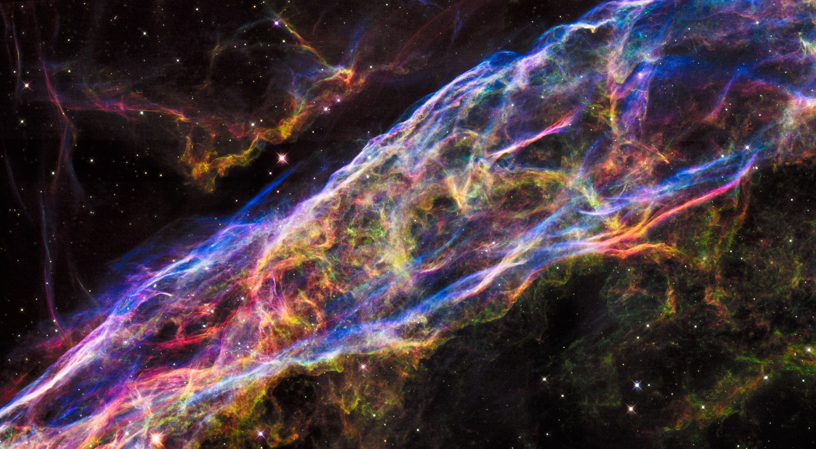
THE ART
IN OUR WORLDS
Treasure Hunt
NasArt

Slide 2


Problem statement

Slide 3
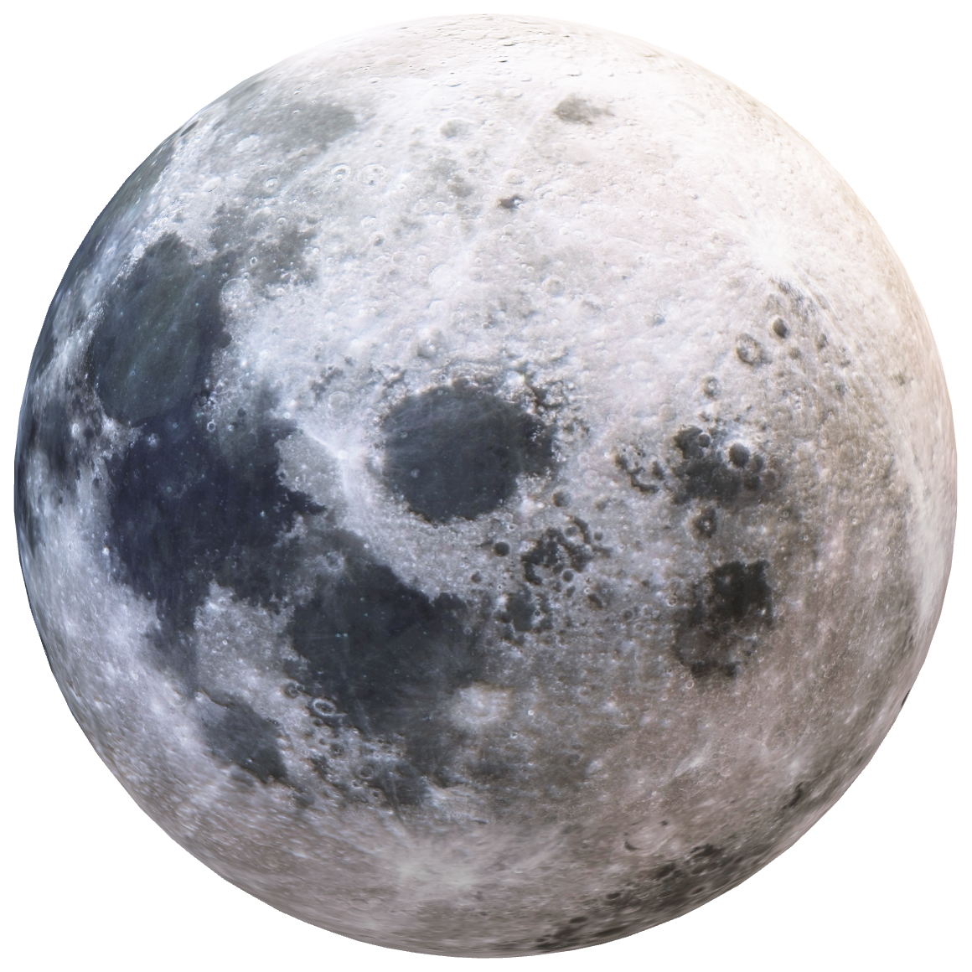
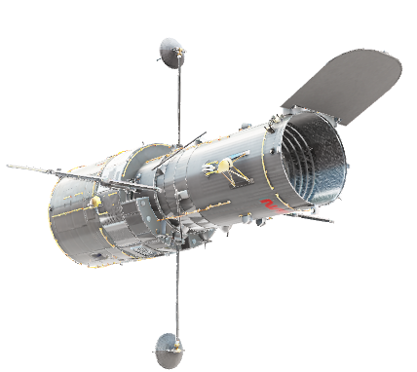

Slide 4
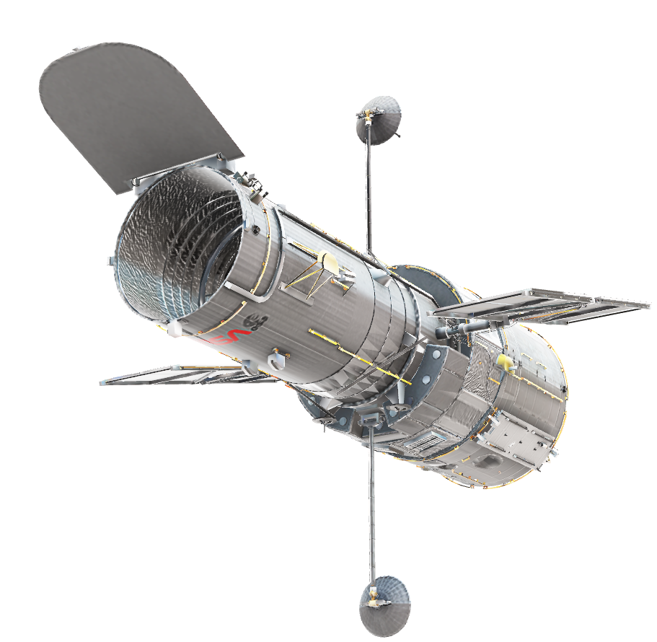
After all this effort a majority of public does not know much about NASA's discoveries

Slide 5
Solution pipeline
Extracting images and their description from NASA earth book
Speech to Text Transcription
Summarization model
Documents Similarity
Creative Distortion of retrieved Images
Text to Speech

Slide 6
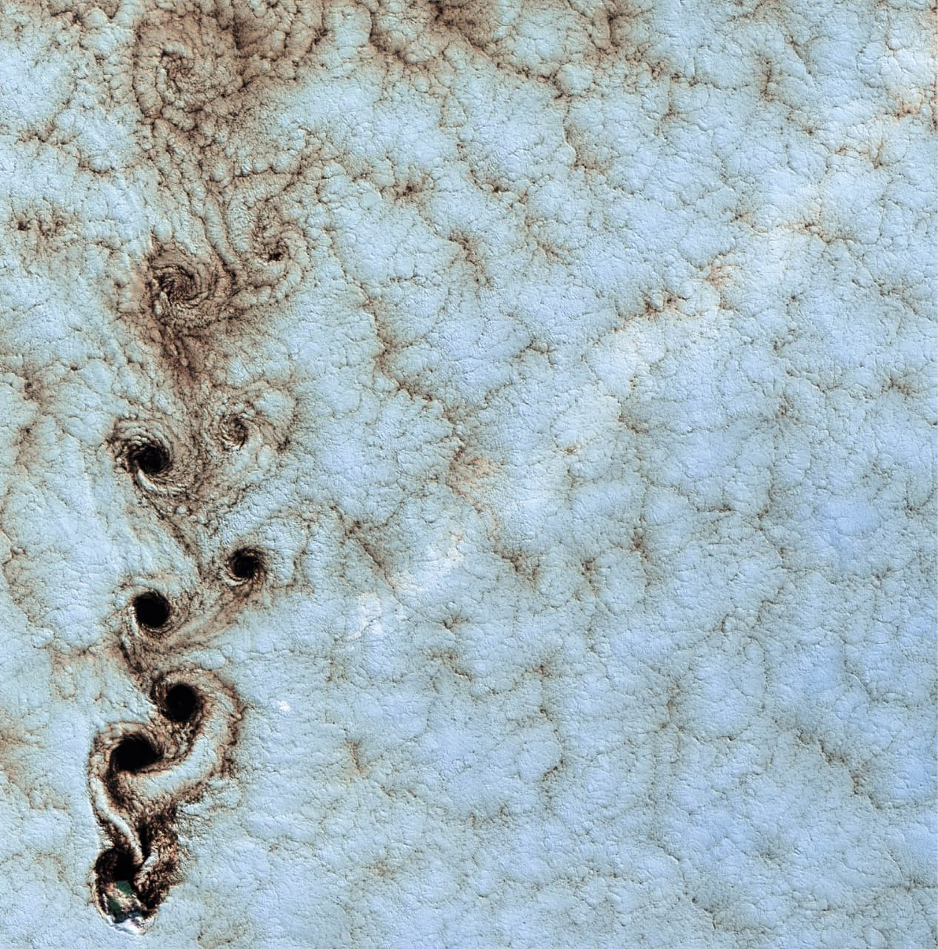
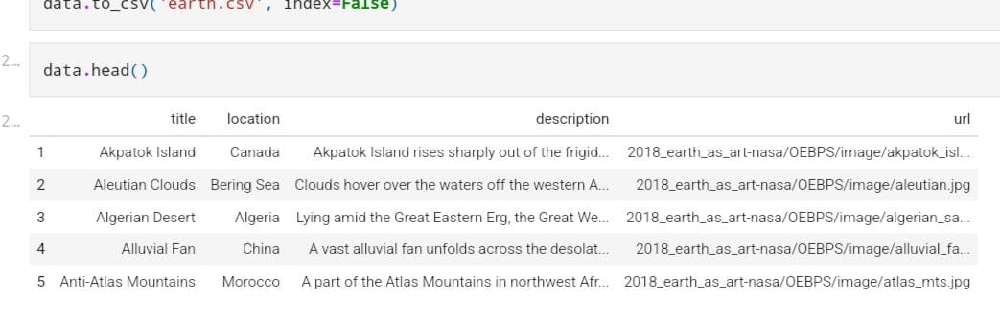
Extracting images and their description from NASA earth book

Slide 7


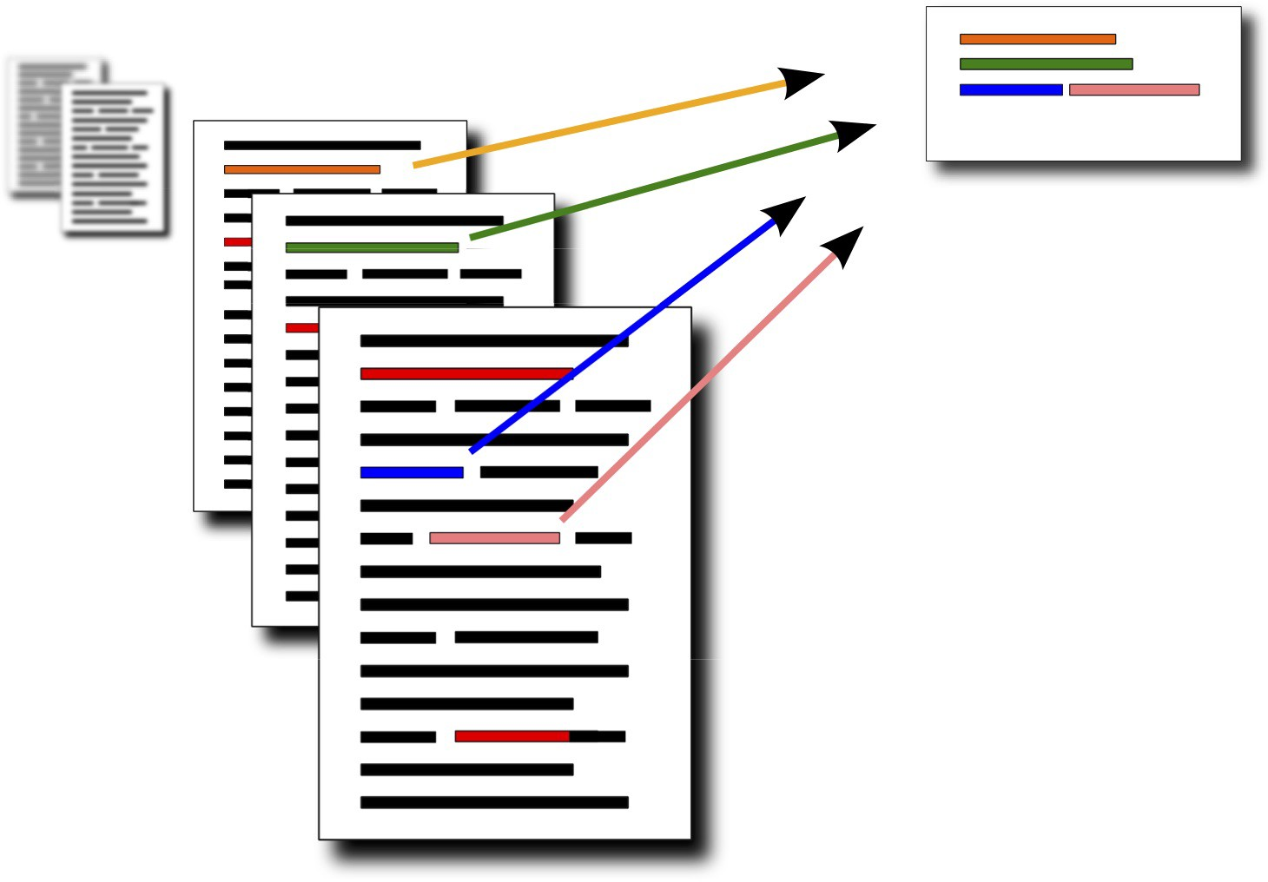
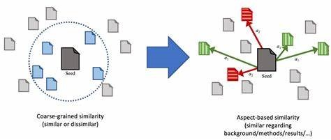
Speech to Text Transcription
Summarization model
Documents Similarity

Slide 8
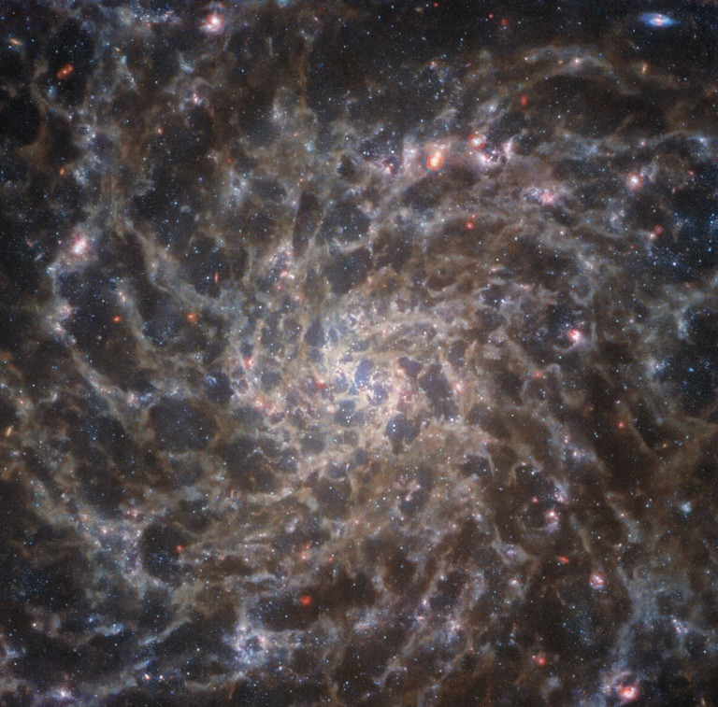
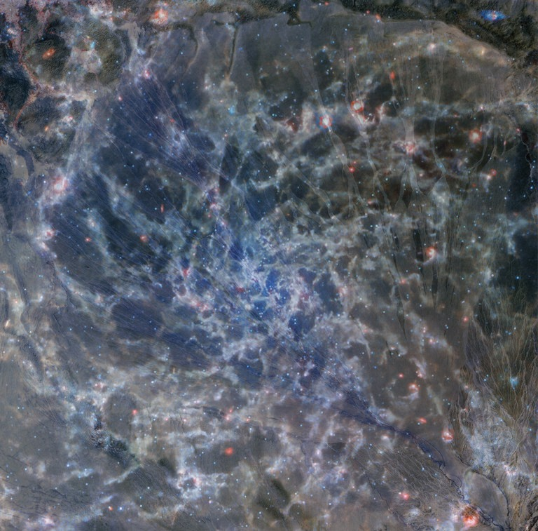
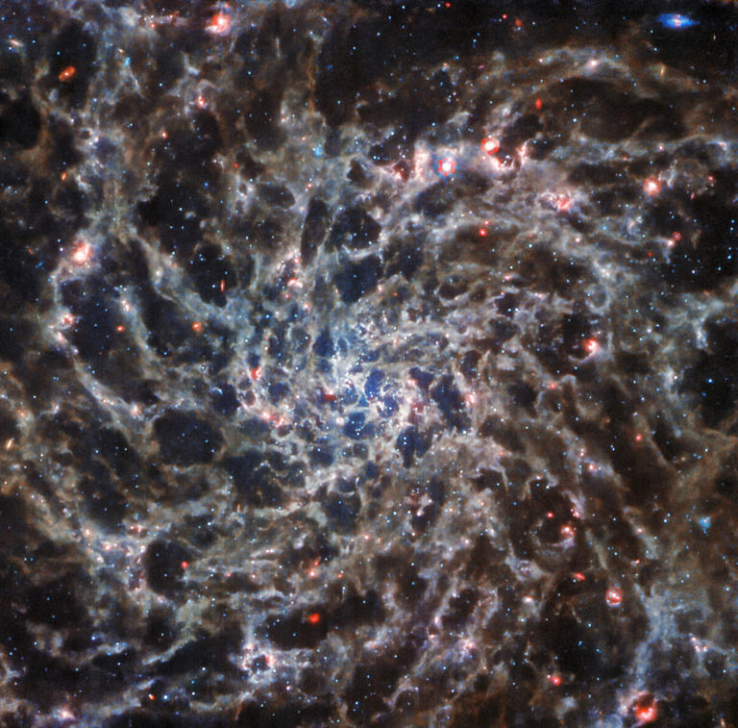
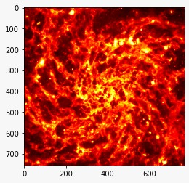
Creative Distortion of retrieved Images

Slide 9

Text to Speech

Slide 10
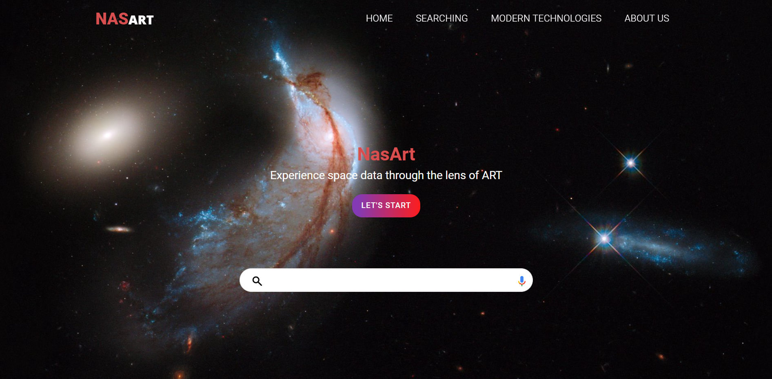
What we provide

Slide 11
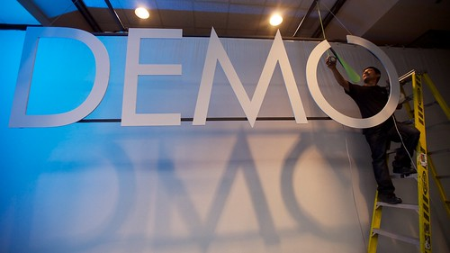
https://youtu.be/elI7RuQDgio

